Slide 1

DISSERTATION ON Real Estate Application (MCA – IV SEMESTER; BATCH 2022-24)
Internal Guide
Dr. Arpita Nagpal (Asst. Prof., BVICAM, New Delhi)
Presentation by
Shubham joshi (03811604422)
Date of Presentation
02-May-24
Notes:
1

Slide 2
Contents
Project Overview
Problem Statement
Project Description
Project Comparison: a comparison study of websites
Application Screenshots
Testing of the project
Features under progress and Conclusion

Slide 3
Project Overview
This minor project aims to build a robust web application using the MERN stack with advanced authentication and search Functionality.
The platform serves as a centralized hub for users to showcase their properties available for rent and sale, providing a seamless experience for both property owners and potential renters or buyers.

Slide 4
Problem Statement
The traditional real estate model relies on middlemen who control limited property selections, charging commissions for connecting owners and seekers, addressing challenges for both parties, but with drawbacks in physical markets due to fewer brokers and market control.

Slide 5
Market Survey
Let’s have a look at the real market scenario:-
The following 6 real estate websites were surveyed to recognize what features can we add in our website-:
NoBroker, Makaan.com, magicbricks,estatesquares,99acres,housing.com
The features mentioned in next slide are collective features of all these websites. No website contained all of them.

Slide 6
Market Survey
The following features can be integrated into the application based on observation
Advanced search functionality
Listing properties
Advanced authentication
Filters
Contacting users
Live Location sharing facility
Integrating other real estate related services
Payment Gateway Integration
Uploading videos along with photos
Home Loan and cost calculator
Facility for sellers to come live and share videos of the location whenever they desire
News Regarding Housing, Trends etc.

Slide 7
Market Survey
Advanced search functionality
Listing properties
Uploading a limited pre-defined no. of Images
Advanced authentication
Filters
Contacting users

Slide 8
PROJECT DESCRIPTION

Slide 9
The project contains:-
Advanced Authentication implemented using JWT, Firebase, and Google OAuth for secure and seamless user access.
Real-world CRUD Operations: Create, read, update, and delete property listings using MongoDB.
User-friendly Features that enhance the user experience with image uploads, property listing management, and more.

Slide 10
Advanced Search Functionality: Cutting-edge search features to help users find what they're looking for.
Deployment Made Easy: Project Deployed for free using the 'render' platform.

Slide 11
Application Screenshots

Slide 12
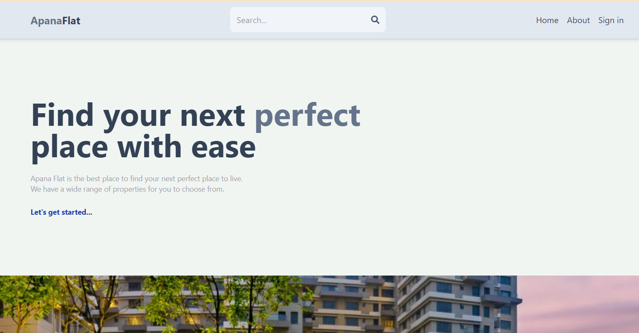
Home Page

Slide 13
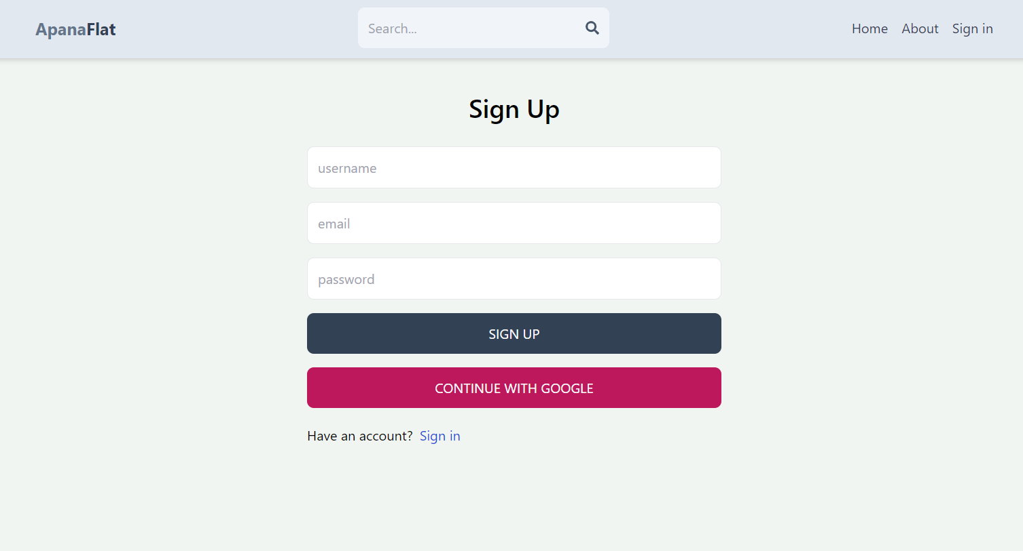
Sign Up Page

Slide 14
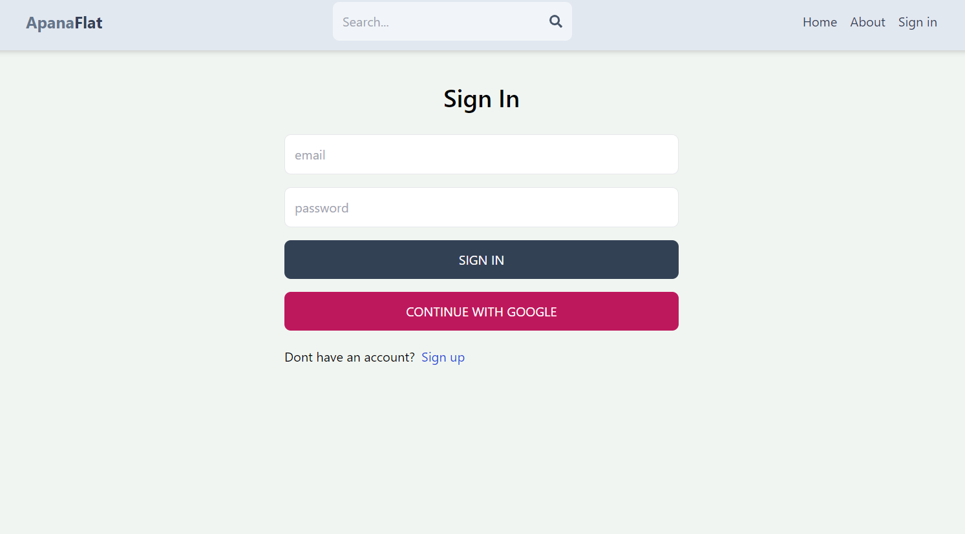
Sign In Page

Slide 15
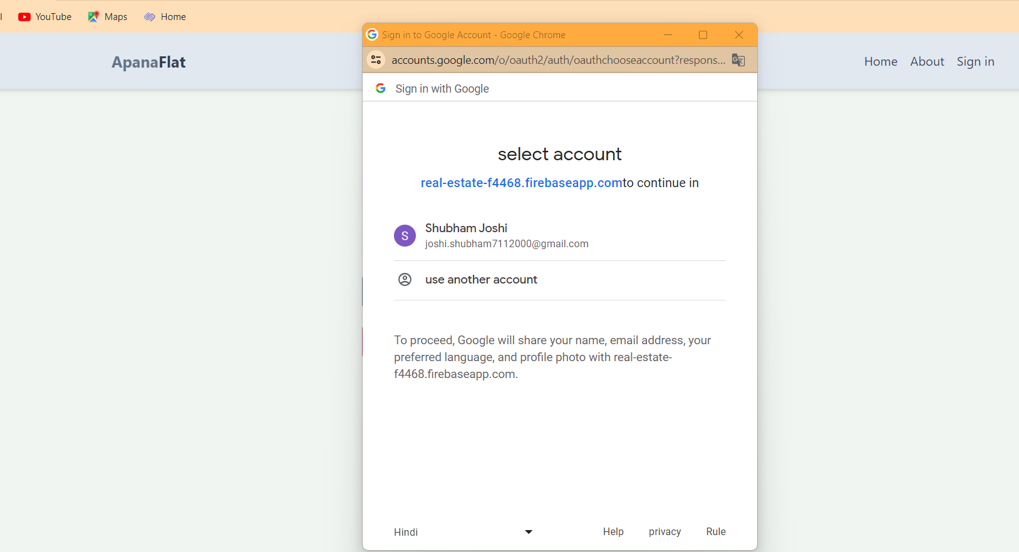
Google Oauth Authentication

Slide 16
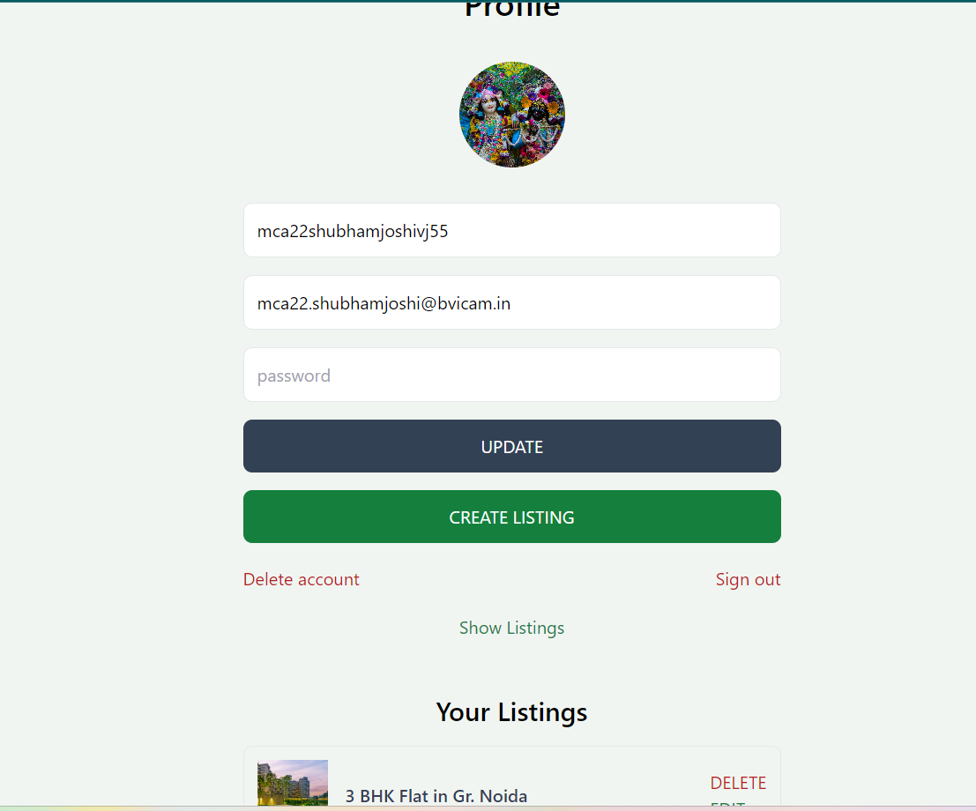
Profile Page

Slide 17
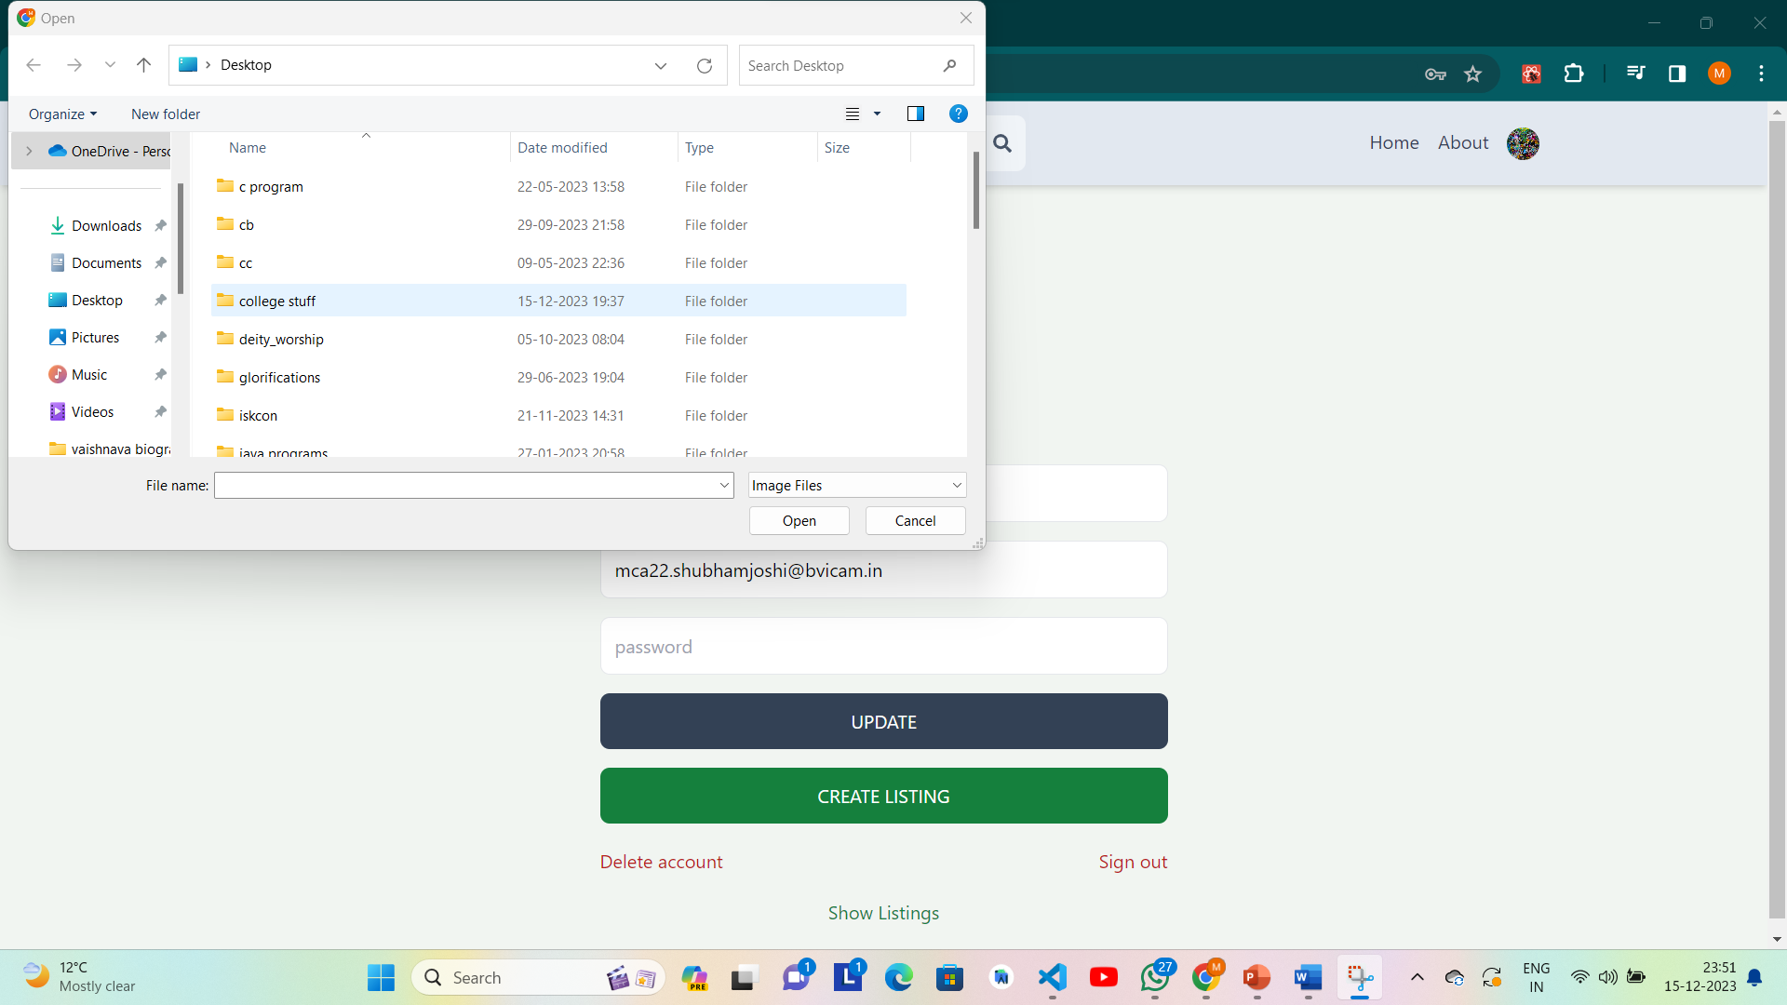
Profile Page

Slide 18
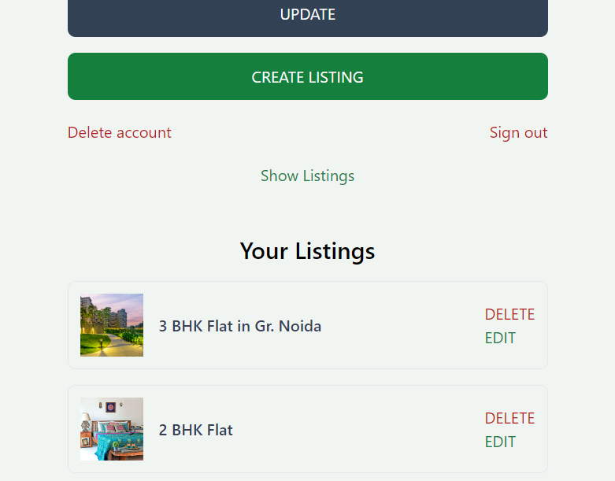
Show Listing

Slide 19
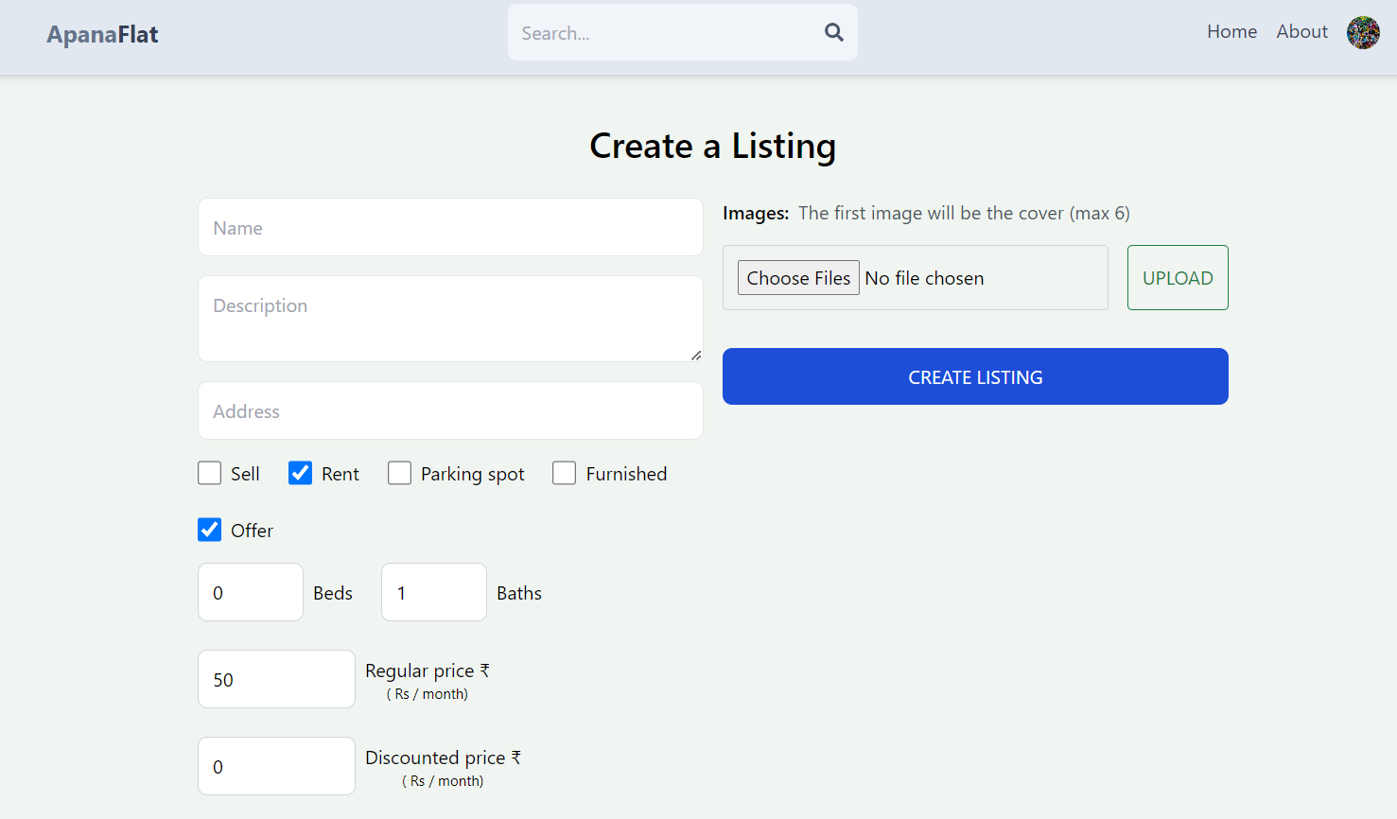
User Listing

Slide 20
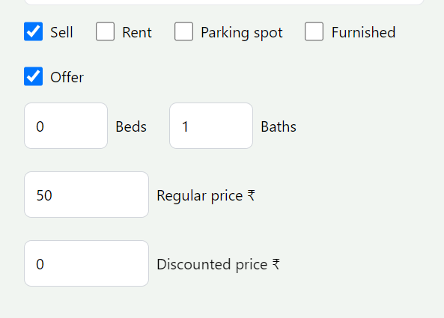
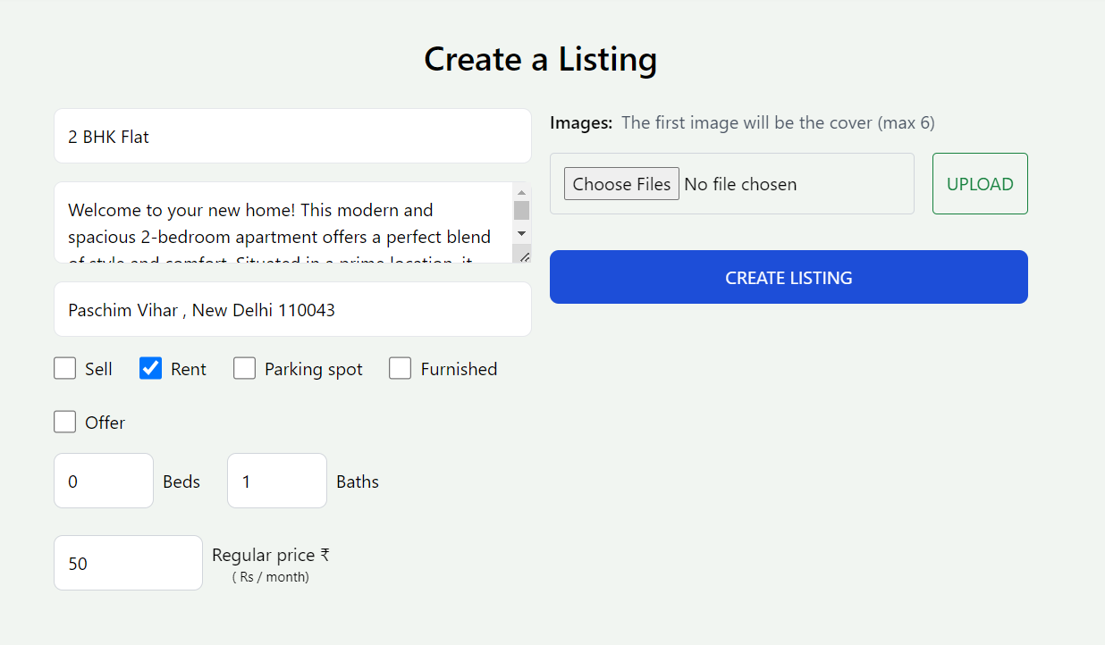
User Listing

Slide 21
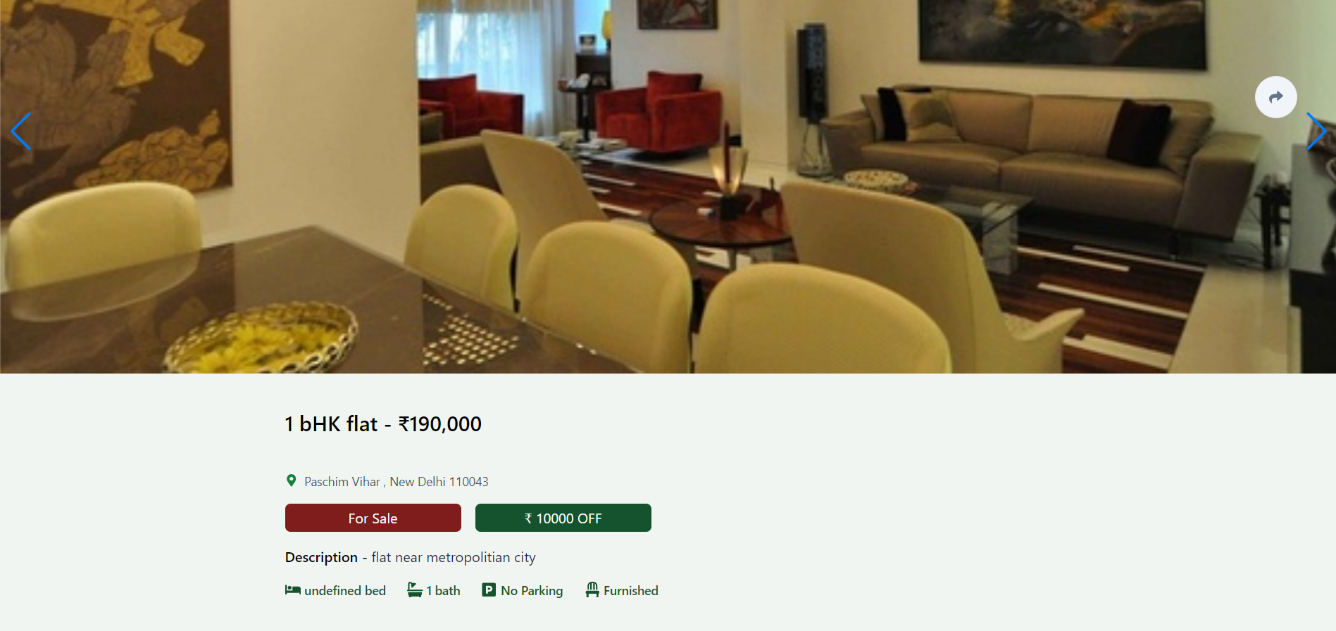

Slide 22
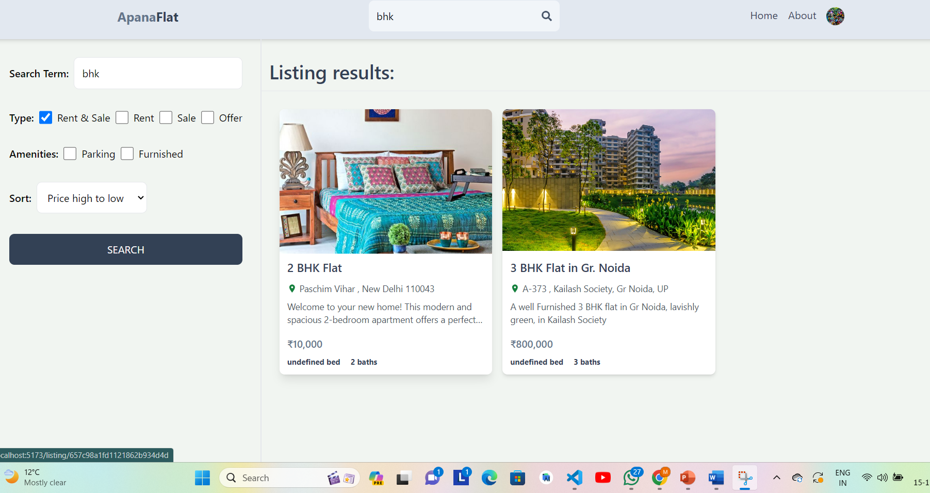
Search Functionality

Slide 23
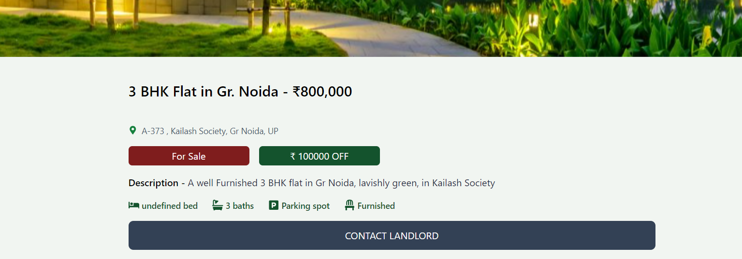
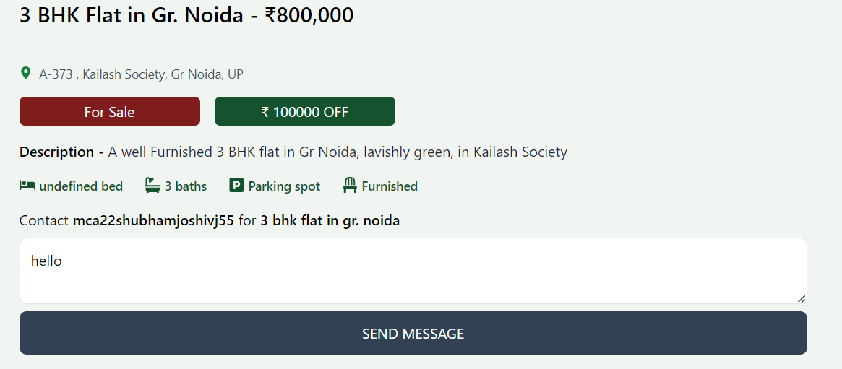
Contacting owner

Slide 24
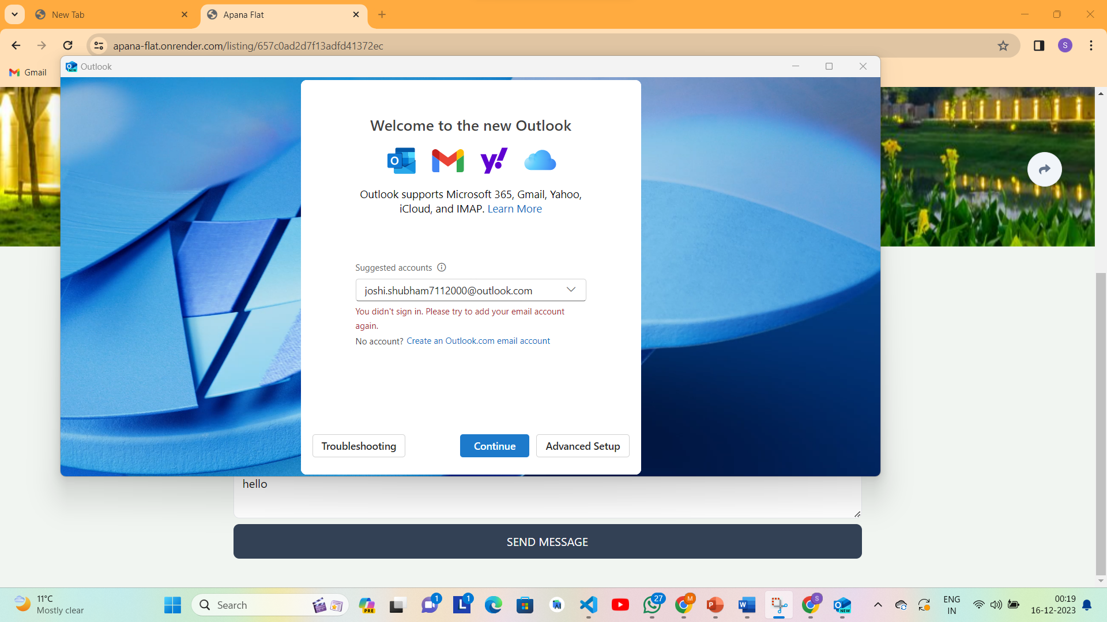
Contacting owner

Slide 25
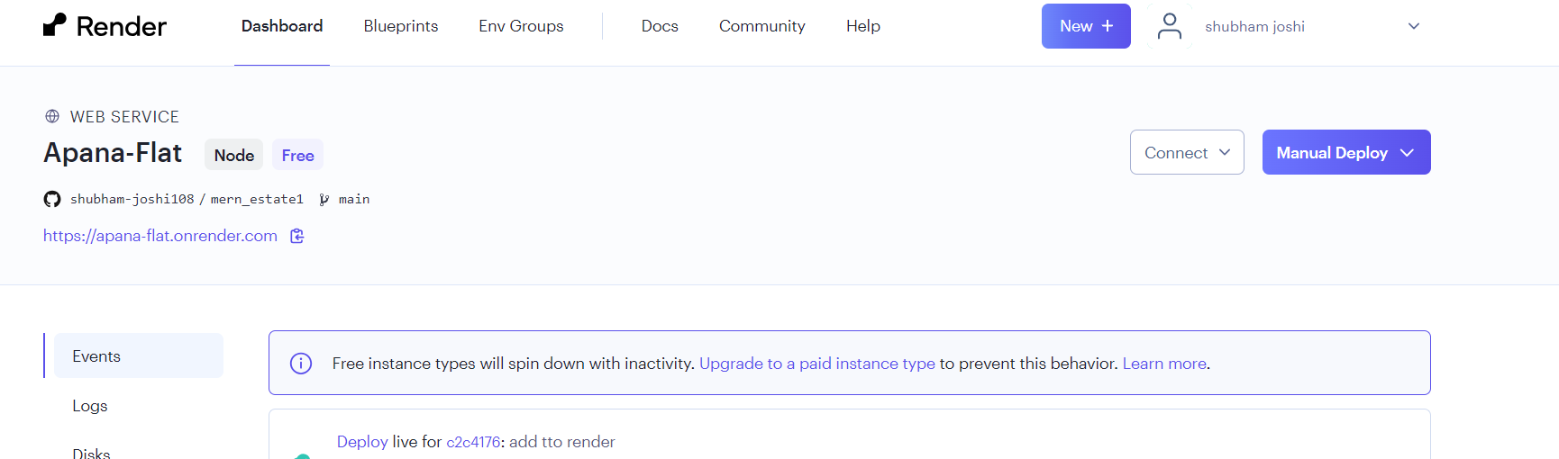
Deployed using Render
https://apana-flat.onrender.com

Slide 26
Testing of the Project
Id | Test Case Description | Test Case Input | Test Results |  | Status | Corrective Measure
 |  |  | Expected | Actual
1 | Admin can successfully create/delete the listing | No input | listing is created successfully | listing is created successfully | Pass | None
2 | All the listings that are successfully created should be displayed here. | No input | Successfully created lists are displayed. | Successfully created orders are displayed. | Pass | None
3 | Google auth sign up | Gmail id | Sign in successful. | Sign in is successful. | Pass | None
4 | Navigation | No input | Produce result on searching | Produce result on searching | Pass | None

Slide 27
Testing of the Project
Id | Test Case Description | Test Case Input | Test Results |  | Status | Corrective Measure
 |  |  | Expected | Actual
5 | Client creating/updating/deleting listing | Text, photos, checkboxes selection | listing is created/updated/deleted successfully |  | Pass | None
6 | Contacting owners | message | Successfully takes user to mail id of owner. | Successfully takes user to mail id of owner. | Pass | None
7 | discount | number | Price should be deducted. | Price should be deducted. | Pass | None

Slide 28
Conclusion
A Web-Based Application for people to buy /sell their properties is deployed using render. The Application has the following features:-
Advanced Authentication Functionality
Advanced Search Functionality
Creating and Updating Listing Facility
Showcasing and Viewing Properties of Other Users.

Slide 29
Future Scope
Payment Gateway Integration
Live Location Facility
Diversified Contact Methods
Review System for Nearby Places
Location-Based Categorization
Uploading videos along with photos
Home Loan and cost calculator
News Regarding Housing, Trends etc

Slide 30
Bibliography
Referred- Books-
www.mongodb.com
https://firebase.google.com
https://react.dev
https://www.javascript.com
https://redux-toolkit.js.org
https://render.com
https://github.com/tailwindlabs/tailwindcss-line-clamp
.

Slide 31


